Slide 1
Course code: ICT 1201 Course Title: Electronic Devices and Circuit Theory Semester: II (July-December’2023) Course Teacher Dr. Monir Morshed Professor, Dept. of ICT Email:monirmorshed.ict@mbstu.ac.bd

Slide 2
Course Contents
Theory of semiconductor: Energy band diagram of conductor, insulator and semiconductor, intrinsic and extrinsic semiconductor, effects of temperature on extrinsic semiconductors, Drift, Diffusion and other carrier theory.
Semiconductors diodes: Theory of p-n junction as diode, Junction diode characteristics and applications, Zener diodes and its application, Schottky Barrier Diodes, Varactor Diodes, Photo Diodes, Tunnel diodes, PIN diode, LCD, Half wave and full wave rectification with filtering and voltage regulators and power supply design.
Bipolar Junction Transistor (BJT): PNP and NPN transistors, principles of operation, biasing and thermal stability, characteristics in different configurations, small signal analysis, BJT amplifiers, π-model, T-model, transistor switching time, equivalent circuits using transconductance parameter for low, medium and high frequency operation of BJT.
Field Effect Transistor (FET): Construction of JFET and MOSFET, characteristics and principles of operation, FET biasing, small signal analysis, introduction to CMOS and its application. Application of FETs as amplifier and switches, load line analysis, equivalent circuits using transconductance parameter for low, medium and high frequency operation of FETs, Ebers-Moll model view; design and analysis of single/multistage amplifiers, power amplifiers, differential amplifiers.
Industrial Semiconductor Device: Structure and basic operation of LED, SCR, UJT, DIAC, TRIAC, photo diodes, phototransistor, solar cells, Concept on vacuum devices.

Slide 3
Recommended Books
Sl. | Book Name |  | Author Name
1. | Microelectronic Circuits | : | Sedra& Smith
2. | Electronic Devices & Circuits | : | Millman&Halkias
3. | Electronic Devices & Circuits | : | Bapat K N
4. | Functional Electronics | : | Ramanan
5. | Pulse Digital and Switching Waveforms | : | Millman&Taub
6. | Electronic Devices & Circuits | : | Allan Mottorshed
7. | Integrated Electronics | : | Millman&Halkias
8. | Electronic Devices & Circuit Theory | : | Boylestead&Neshelsky
9. | Electronic Circuits ,Discrete & Integrated” | : | Schilling &Belove
10. | Priciples of Electronics | : | K Metha

Slide 4
Course Objectives
To introduce basic semiconductor devices, their characteristics and application
To understand analysis and design of simple diode circuit
To learn to analyze the PN junction behavior at the circuit level and its role in the operation of diodes and active device

Slide 5
Course Outcomes
CO 1: Ability to analyze PN junctions in semiconductor devices under various conditions.
CO 2: Ability to design and analyze simple rectifiers and voltage regulators using diodes.
CO 3: Ability to describe the behavior of special purpose diodes.
CO 4: Ability to design and analyze simple BJT and MOSFET circuits.

Slide 6
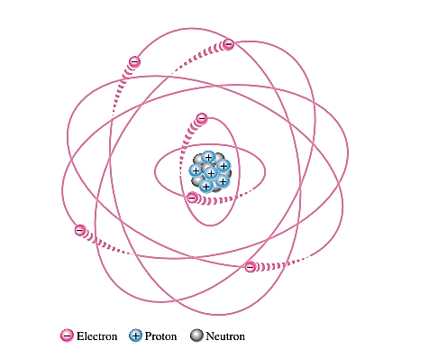
The Atom
All matter is composed of atoms; all atoms consist of electrons, protons, and neutrons except normal hydrogen, which does not have a neutron.
Fig.: The Bohr model of an atom showing electrons in orbits around the nucleus, which consists of
protons and neutrons. The “tails” on the electrons indicate motion.

Slide 7
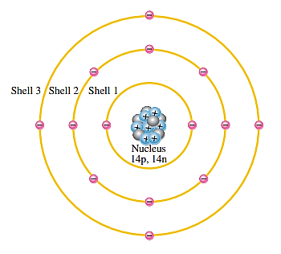
Electrons and Shells
Electrons orbit the nucleus of an atom at certain distances from the nucleus. Electrons near the nucleus have less energy.
Each discrete distance (orbit) from the nucleus corresponds to a certain energy level. In an atom, the orbits are grouped into energy levels known as shells.
Fig.: Illustration of the Bohr model of the silicon atom.

Slide 8
Valance Electrons and Ionization
Electrons with the highest energy exist in the outermost shell of an atom and are relatively loosely bound to the atom. This outermost shell is known as the valence shell and electrons in this shell are called valence electrons.
Valance electrons contribute to chemical reactions and bonding
Valance electrons can break from its atom with gaining sufficient energy from external source.
If a valance electrons acquires a sufficient amount of energy, called ionization energy, the valance electrons can escape from the outer shell (also called valance shell). The process of losing a valence electron is known as ionization.
The escaped valance electron is called a free electron.
And resulting positively charged atom is called a positive ion.
The atom that has acquired the extra electron is called a negative ion.

Slide 9
Materials in Electronics
An insulator is a material that does not conduct electrical current under normal conditions. Valence electrons are tightly bound to the atoms; therefore, there are very few free electrons in an insulator. Examples of insulators are rubber, plastics, glass, mica, and quartz.
A conductor is a material that easily conducts electrical current such as copper (Cu), silver (Ag), gold (Au), and aluminum (Al), which are characterized by atoms with only one valence electron very loosely bound to the atom.
A semiconductor is a material that is between conductors and insulators in its ability to conduct electrical current. A semiconductor in its pure (intrinsic) state is neither a good conductor nor a good insulator. Single-element semiconductors are antimony (Sb), arsenic (As), astatine (At), boron (B), polonium (Po), tellurium (Te), silicon (Si), and germanium (Ge). Compound semiconductors such as gallium arsenide, indium phosphide, gallium nitride, silicon carbide, and silicon germanium are also commonly used. The single-element semiconductors are characterized by atoms with four valence electrons. Silicon is the most commonly used semiconductor.

Slide 10
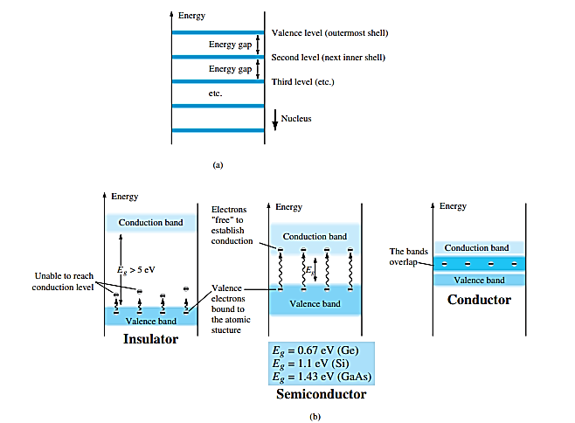
Band Gap or Energy Gap
When an electron acquires enough additional energy, it can leave the valence shell, become a free electron, and exist in what is known as the conduction band. The difference in energy between the valence band and the conduction band is called an energy gap or band gap.
Energy levels: (a) discrete levels in isolated atomic structures; (b) conduction and valence bands of an insulator, a semiconductor, and a conductor.

Slide 11
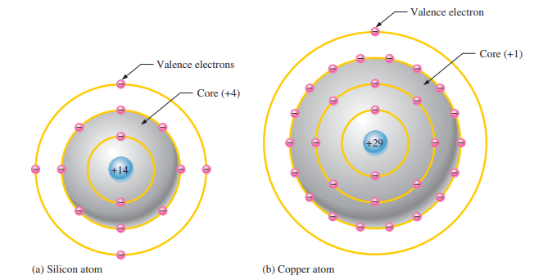
Comparison of a Semiconductor Atom to a Conductor Atom
Silicon is a semiconductor and copper is a conductor. Notice that the core of the silicon atom has a net charge of 4 (14 protons 10 electrons) and the core of the copper atom has a net charge of 1 (29 protons 28 electrons).

Slide 12
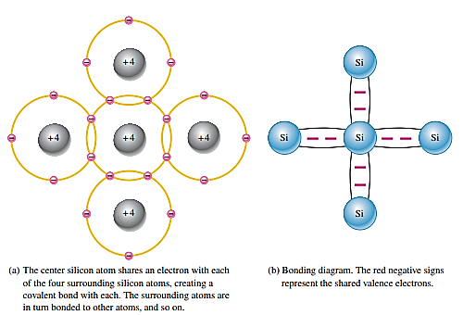
Covalent Bonds
This bonding of atoms, strengthened by the sharing of electrons, is called covalent bonding.

Slide 13
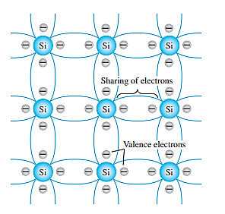
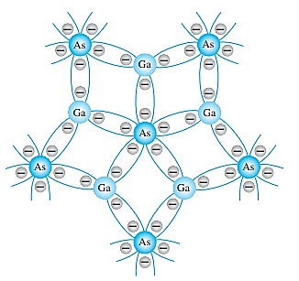
Covalent Bonds
Covalent bonding of the silicon atom.
Covalent bonding of the GaAs crystal.

Slide 14
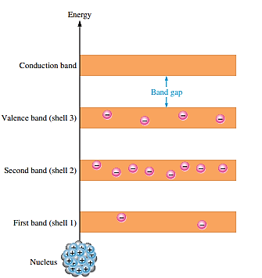
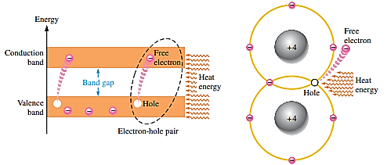
Conduction Electrons and Holes
An intrinsic (pure) silicon crystal at room temperature has sufficient heat (thermal) energy for some valence electrons to jump the gap from the valence band into the conduction band, becoming free electrons. Free electrons are also called conduction electrons.
It leaves vacancy in the valence band within the crystal. This vacancy is called a hole.
Recombination occurs when a conduction-band electron loses energy and falls back into a hole in the valance band.

Slide 15
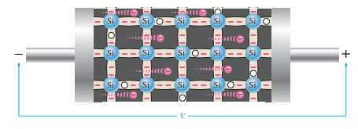
Electron and Hole Current
In conduction band: when a voltage is applied across a piece of intrinsic silicon, the thermally generated free electrons in the conduction band, are now easily attracted toward the positive end, this movement of free electrons create a current is called electron current.
Electron current in intrinsic silicon is produced by the movement of thermally generated free electrons.
In valance band: In the valence band, holes generated due to free electrons. Electrons in the valence band are although still attached to their atoms and are not free to move randomly, however, they can move into a nearby hole with little change in its energy level, thus leaving another hole where it came from. Effectively the hole has moved from one place to another in the crystal structure it is called hole current.

Slide 16
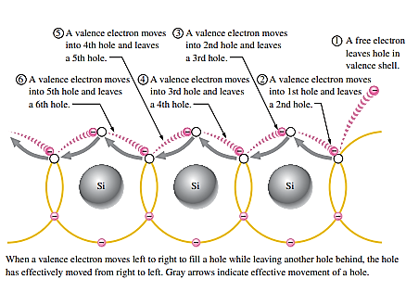
Electron and Hole Current

Slide 17
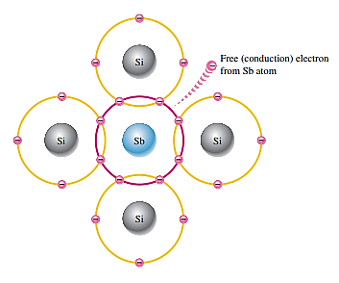
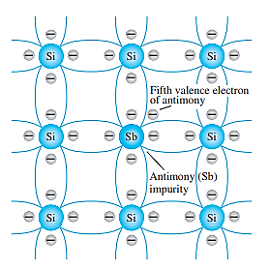
N-type semiconductor
Semiconductive materials do not conduct current well and are of limited value in their intrinsic state because of the limited number of free electrons in the conduction band and holes in the valence band.
Adding impurities to the intrinsic (pure) semiconductive material to drastically increased their conductivity is called doping.
Since, the pentavalent atom gives up an electron, it is often called a donor atom.
Majority carrier is electrons and minority carrier is holes

Slide 18
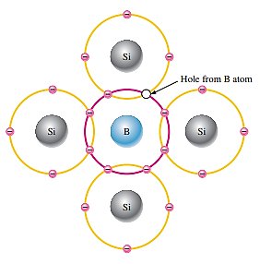
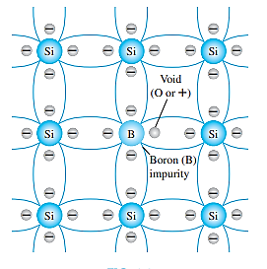
P-type semiconductor
The p -type material is formed by doping a pure germanium or silicon crystal with impurity atoms having three valence electrons such as boron, gallium, and indium.
Because the trivalent atom can take an electron, it is often referred to as an acceptor atom.
Majority carrier is holes and minority carrier is electrons.

Slide 19
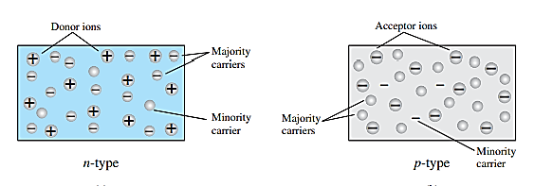
Majority and Minority Carriers
In an n-type material the electron is called the majority carrier and the hole the minority carrier.
In a p-type material the hole is the majority carrier and the electron is the minority carrier.

Slide 20
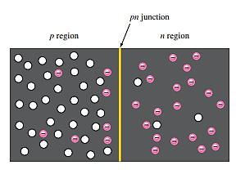
PN-Junction and Depletion Region
When a p-type materials are combined with n-type materials, a pn junction forms and a semiconductor diode is created.
When the pn junction is formed, the n region loses a free electron as they diffuse across the junction and combines with a hole, a positive charge is left in the n region and a negative charge is created in the p region, forming a barrier potential. This region of uncovered positive and negative ions is called the depletion region due to the “depletion” of free carriers in the region.
https://www.youtube.com/watch?v=4SlfaocMfdA

